Slide 1


HARDWARE.astronomy
Housekeeping Box
Adam Stammer
Under the Direction of Dr. Carl Ferkinhoff

Slide 2
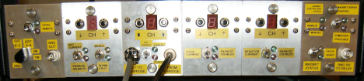
Motivations
Obsolete Internal Chips
Multiplexer Readout Rate Limit
Dependent On PC

Slide 3
Abstract Goals
Open Source
Versatile
Cheap
Design Steps
Prototyping Daughtercard (P-Card)
Backplane
ZEUS2 Daughtercards
Chassis and Accompanying Components
Communication Programming
Goals

Slide 4
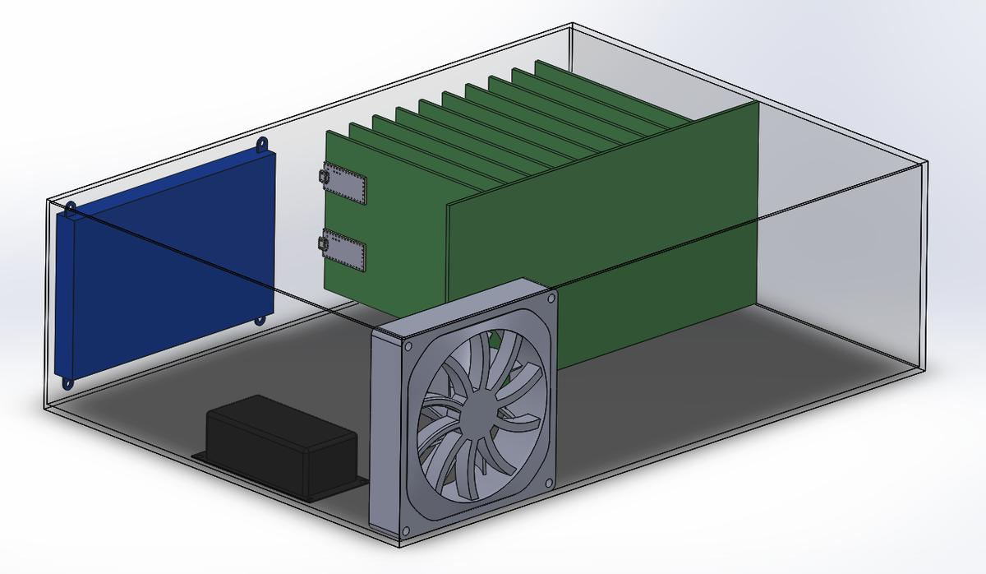
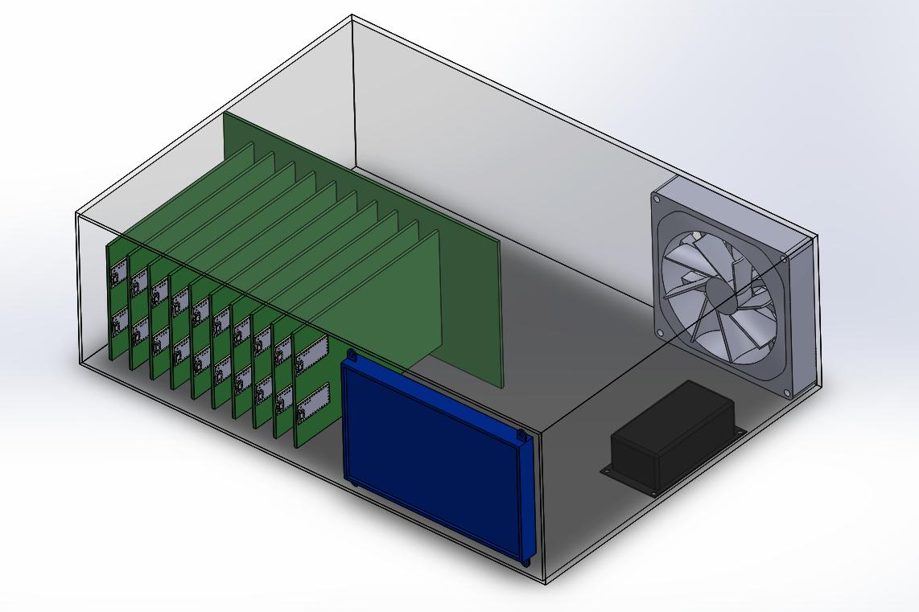
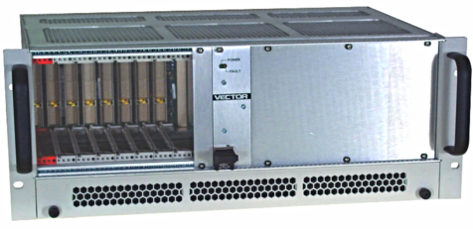
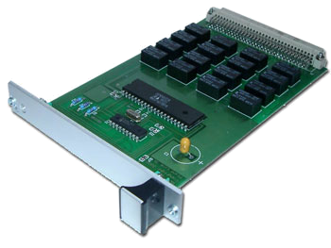
Draft Render and Similar Products
Touch Screen
Backplane & Daughtercards
Cooling Fan
Power Supply

Slide 5
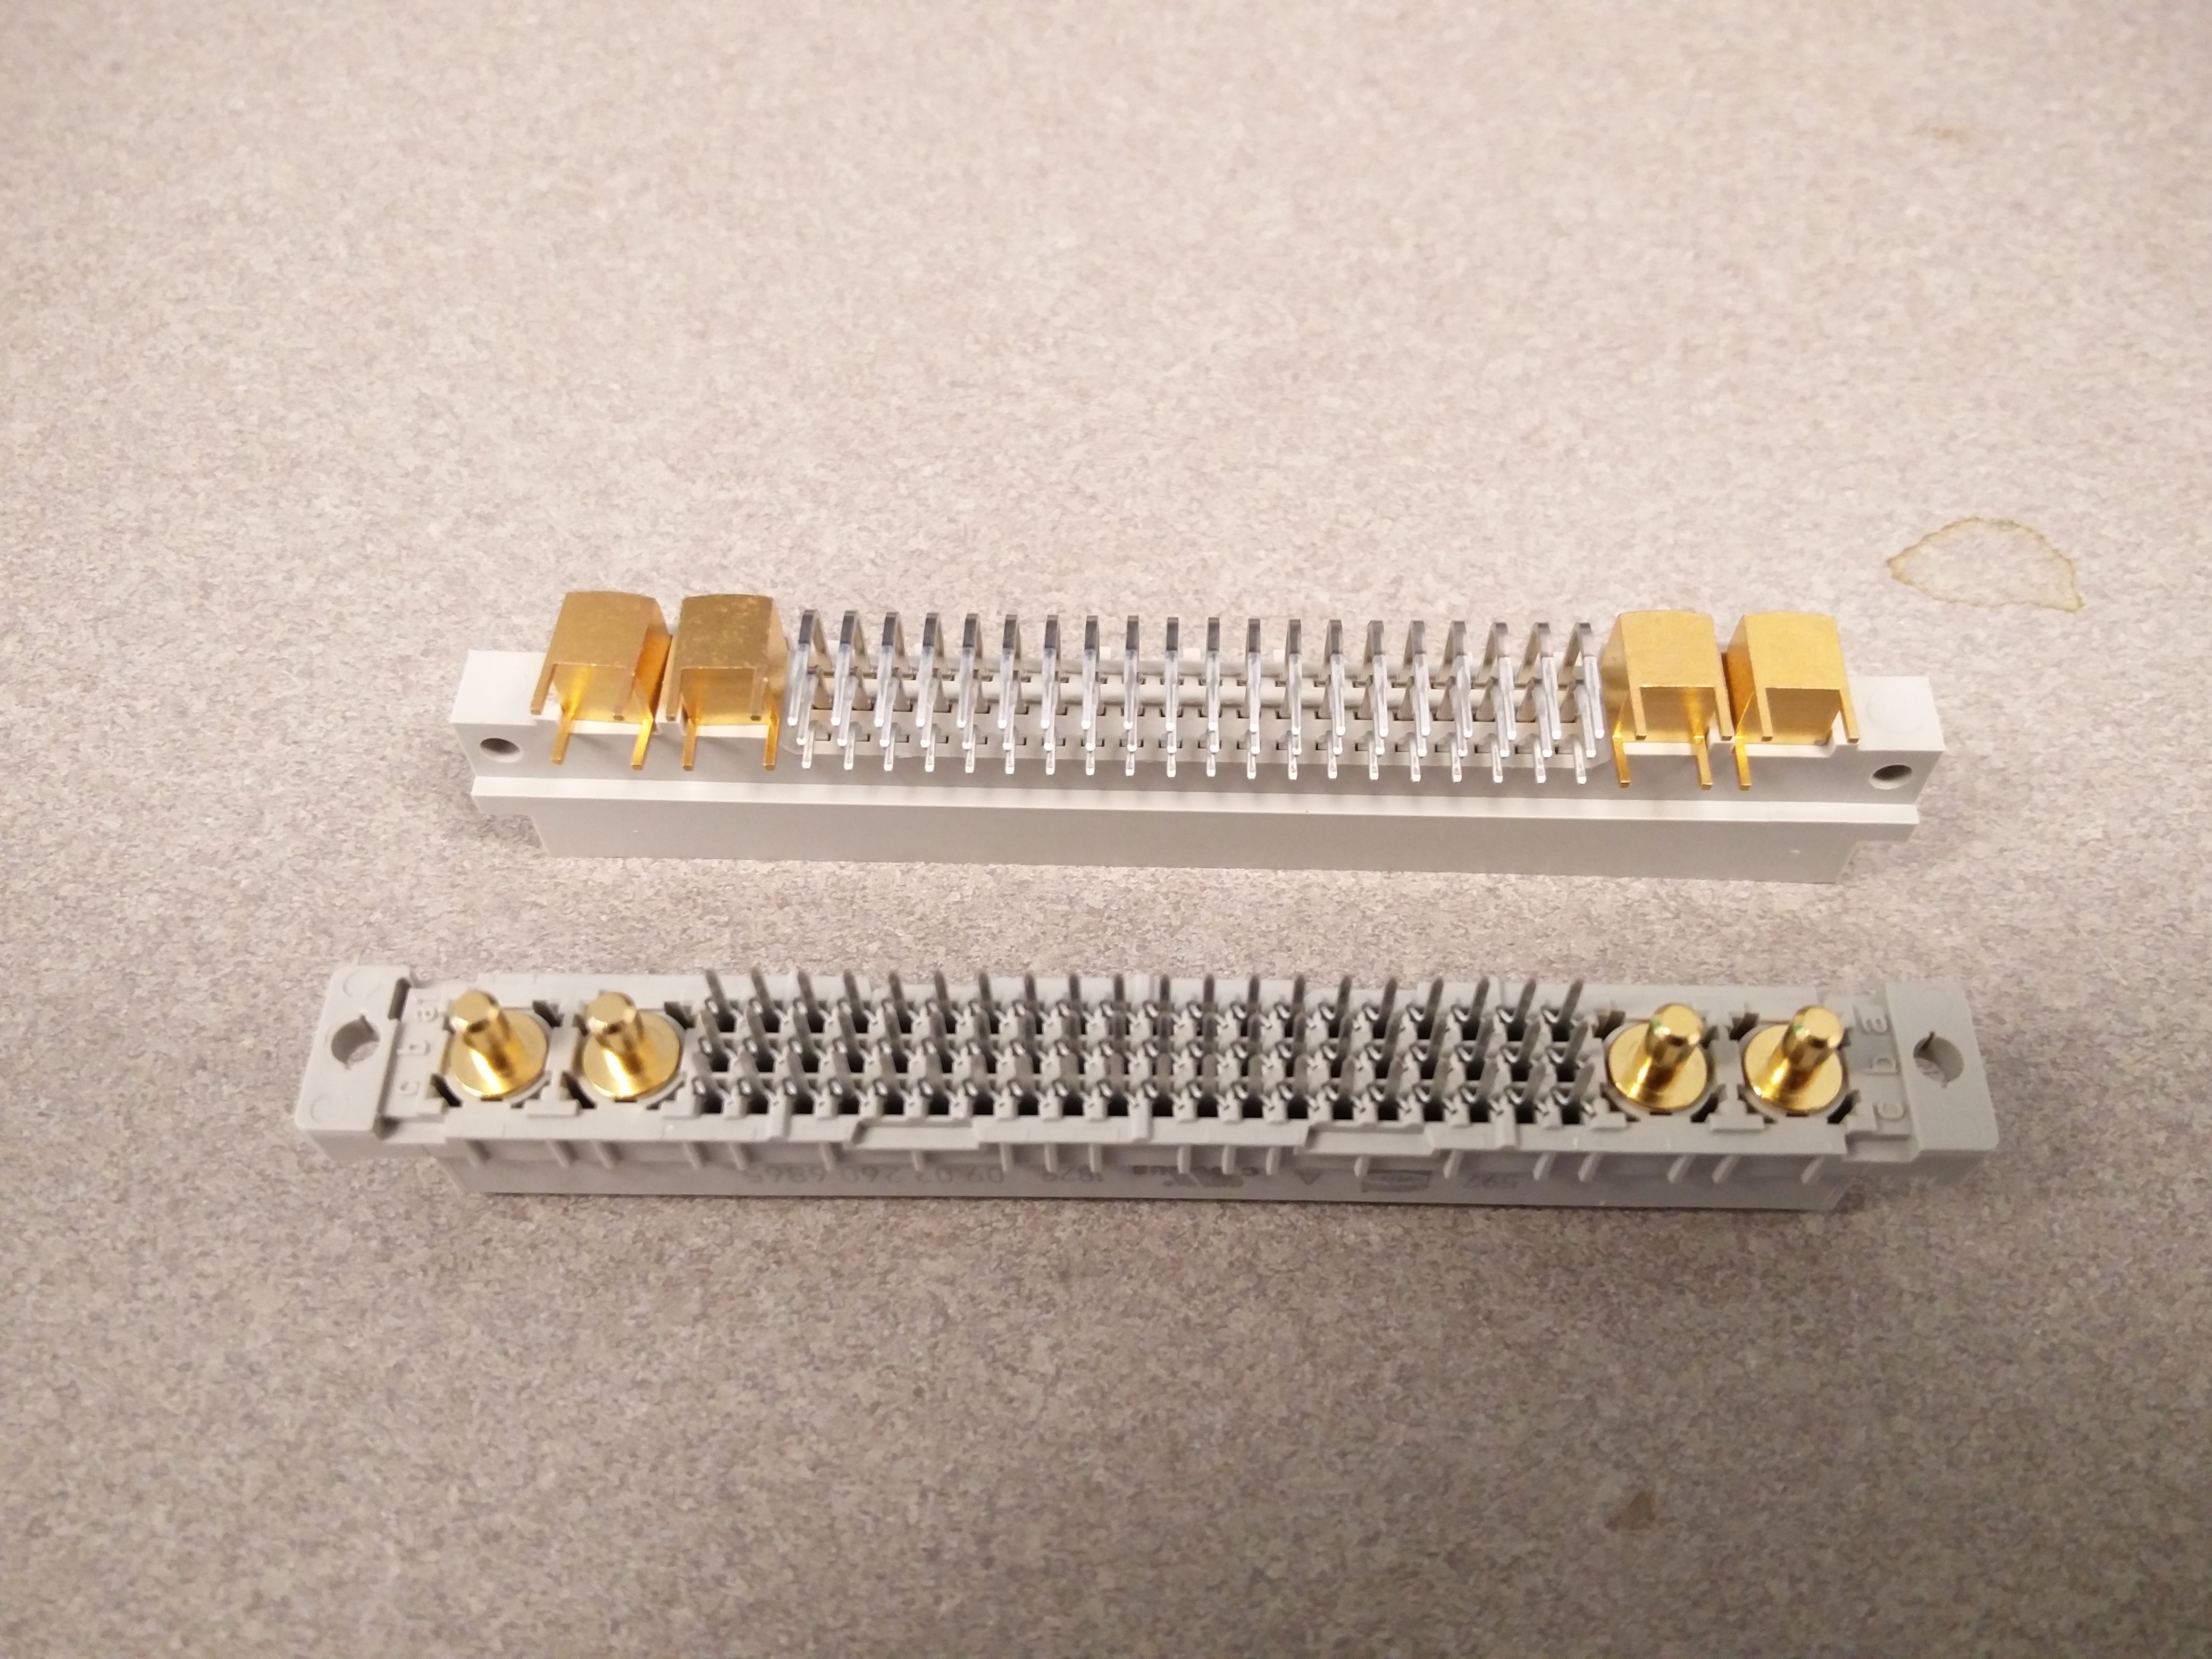
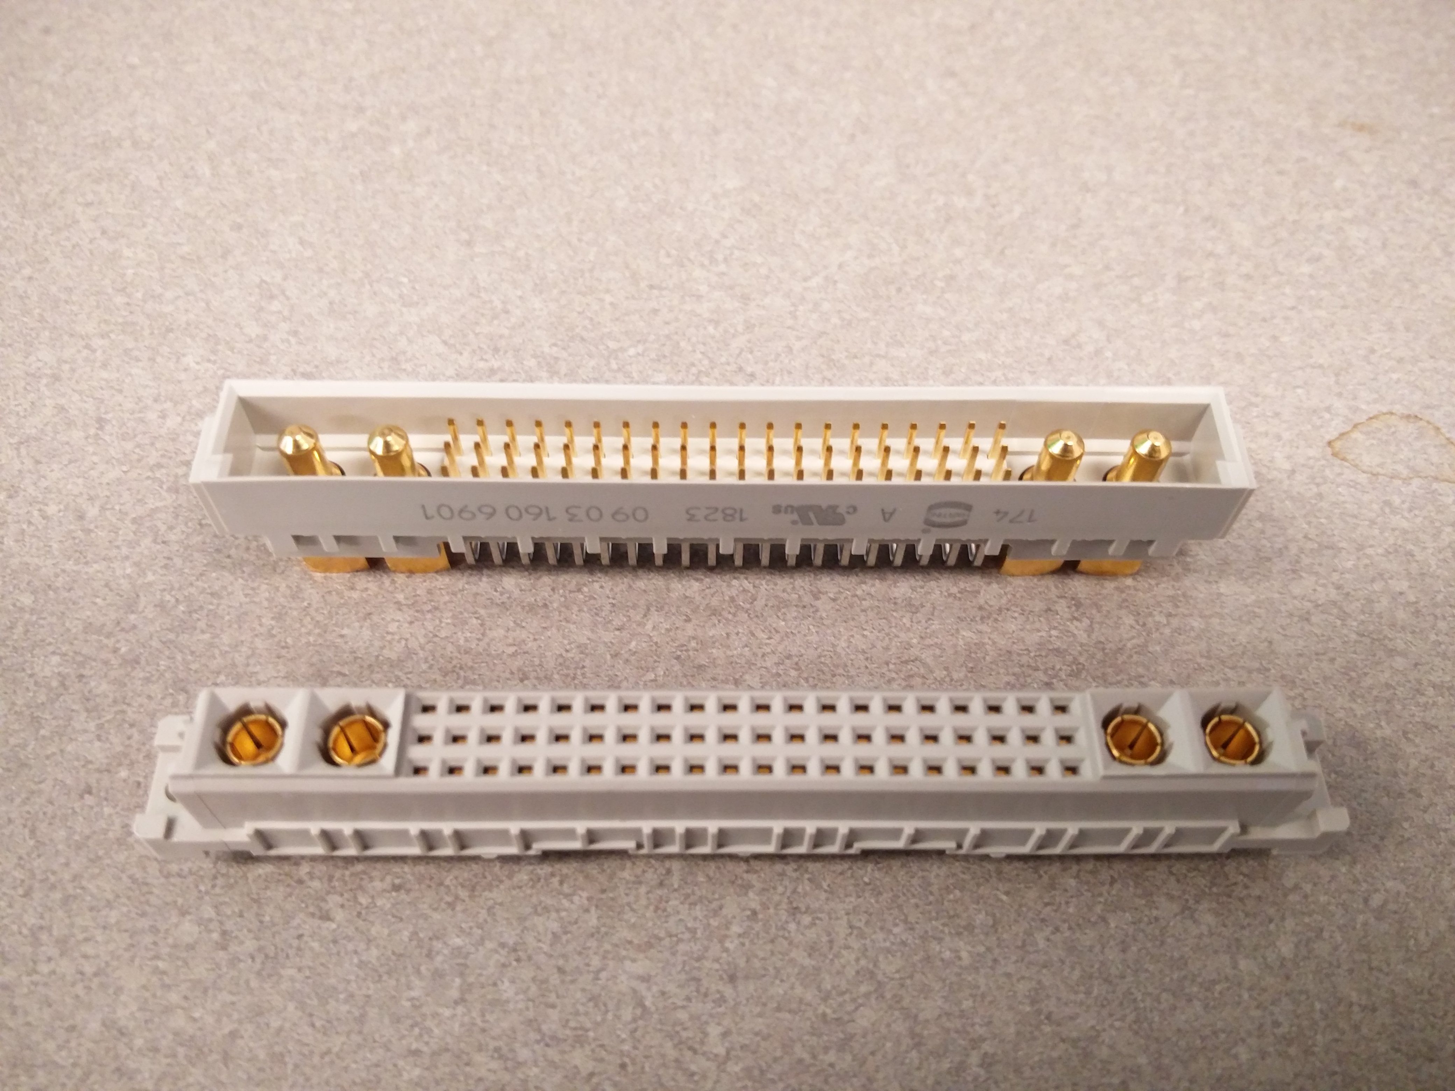
60 Pins @ 2 Amps and 4 High Current Pins @ 20 Amps
Sockets

Slide 6
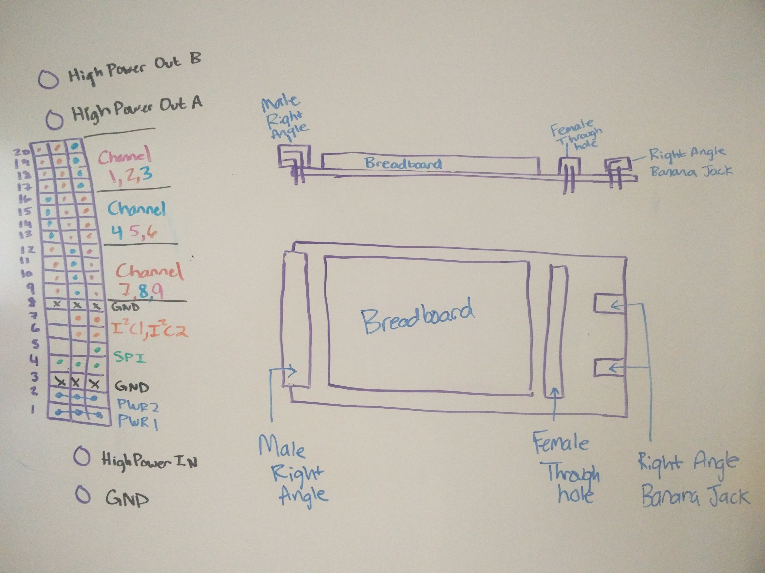
Male Socket, Female Socket, Breadboard, High Power Banana Jacks, Double Length For Easy Access
Prototyping Card (P-Card)
Sketch

Slide 7
Male Socket, Female Socket, Breadboard, High Power Banana Jacks, Double Length For Easy Access
Prototyping Card (P-Card)
Sketch

Slide 8
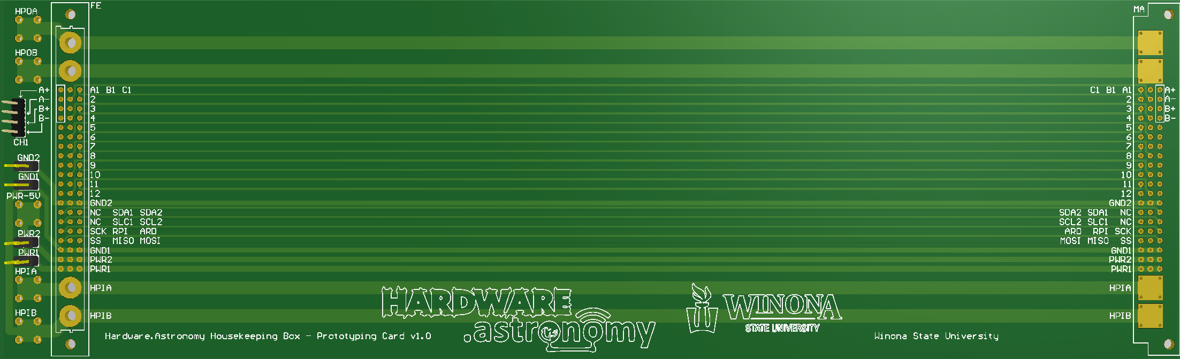
IO Channel
Sockets
High Power IO
High Power Input
Space For
Solderless Breadboard(s)
Low Power Jumpers
P-Card PCB

Slide 9
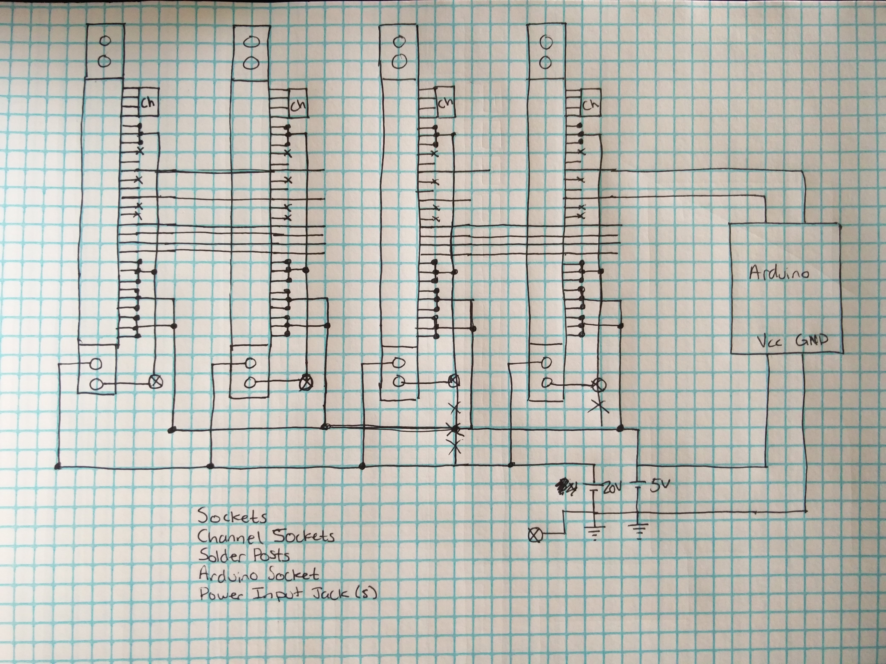
Sockets, Power, SPI, HP Signal I/O, 9 4-pin signal I/Os per card, Arduino Controller (with I2C), On board Temperature Sensors, 7-segment digit display, 5Volt and 20Volt Power, Raspberry Pi (with I2C), Interrupts from Arduino and Pi
Backplane
Simplified
Schematic
Sketch

Slide 10
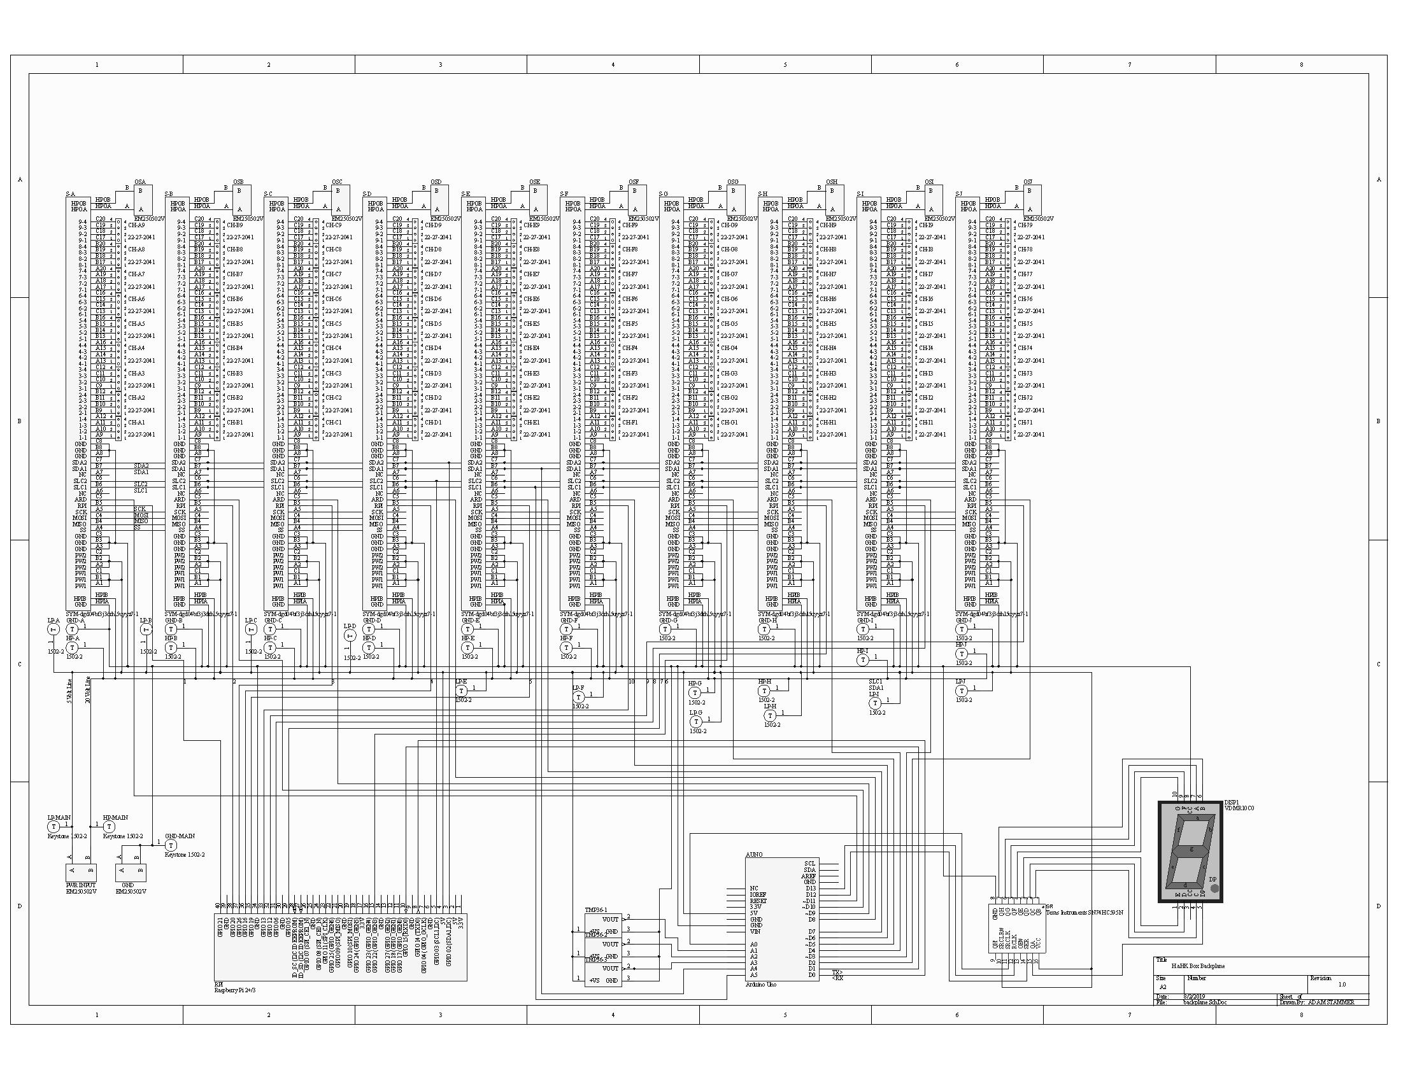
Sockets, Power, SPI, HP Signal I/O, 9 4-pin signal I/Os per card, Arduino Controller (with I2C), On board Temperature Sensors, 7-segment digit display, 5Volt and 20Volt Power, Raspberry Pi (with I2C), Interrupts from Arduino and Pi
Backplane
Schematic

Slide 11

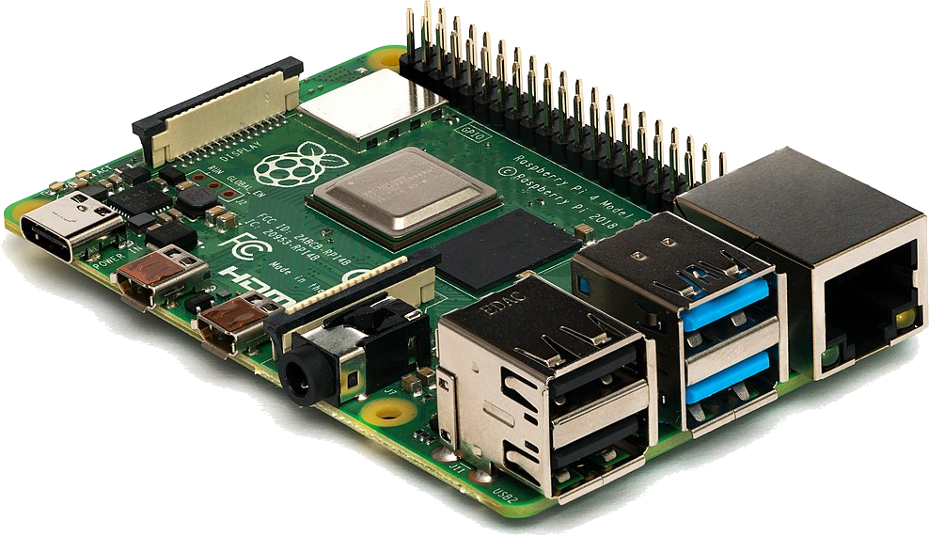

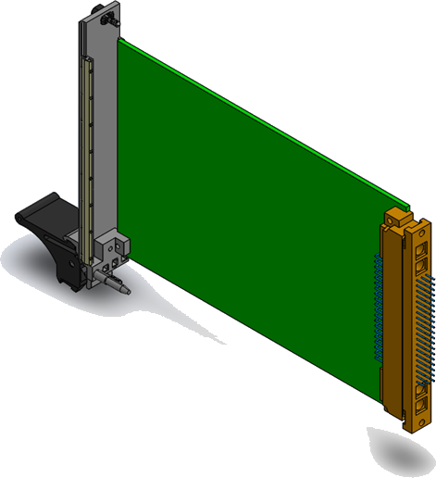
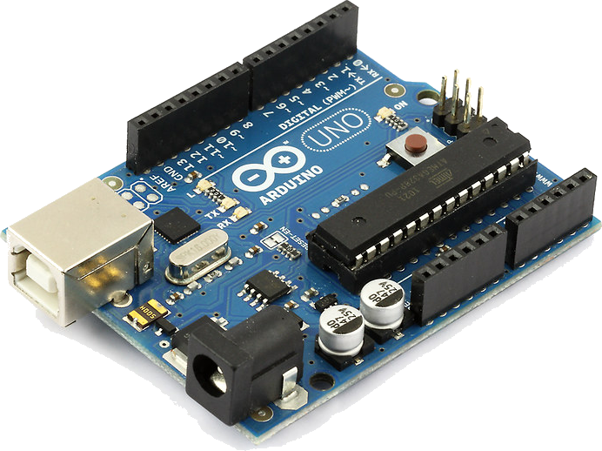

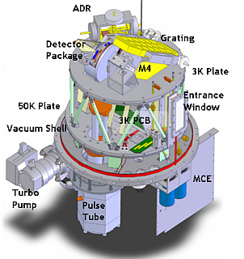

Touchscreen
Raspberry Pi
Microcontrollers
Communication Example
-200°C
Cooler Controller
ZEUS2
Arduino
Temperature Sensor

Slide 12
Finish Backplane PCB Layout
Manufacture
Program Controllers
Finish Daughtercard Designs
Next Steps

Slide 13
Sources
https://www.circuitbasics.com/
https://www.arduino.cc/
https://www.raspberrypi.org/
https://sites.google.com/site/carlferkinhoff/welcome-1 (thanks Carl)
http://hosting.astro.cornell.edu/~spifiweb/zeus2/index.html

